Slide 1
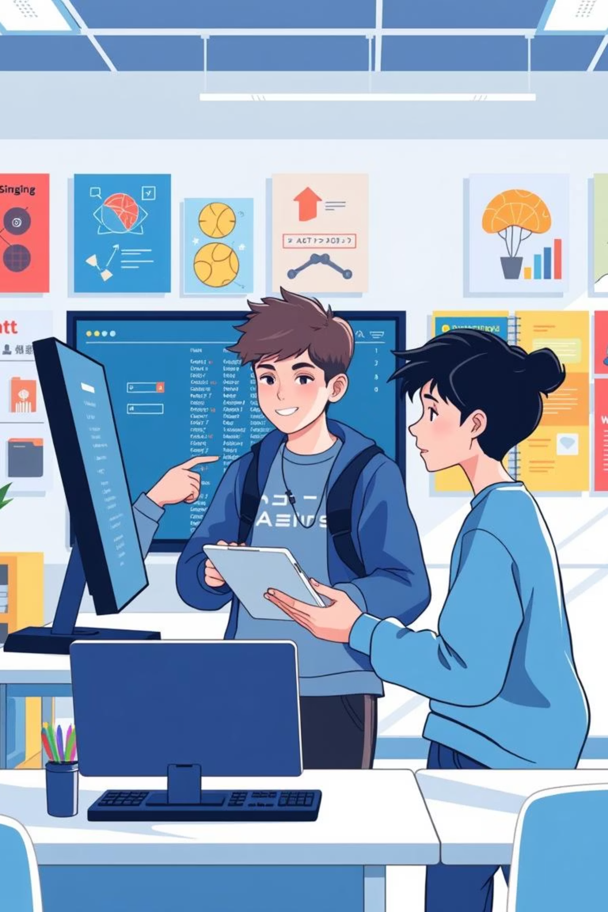
Lesson 6: Putting It All Together
Welcome to the final lesson! Today, we're combining everything you've learned into amazing interactive systems.
Events (collision, landing, free fall)
Variables (storing and changing data)
IF statements (making decisions)
Sensors (accelerometer, light sensor)
Loops (efficient repetition)
Your challenge: create complete interactive systems that feel like real games or smart devices!

Slide 2
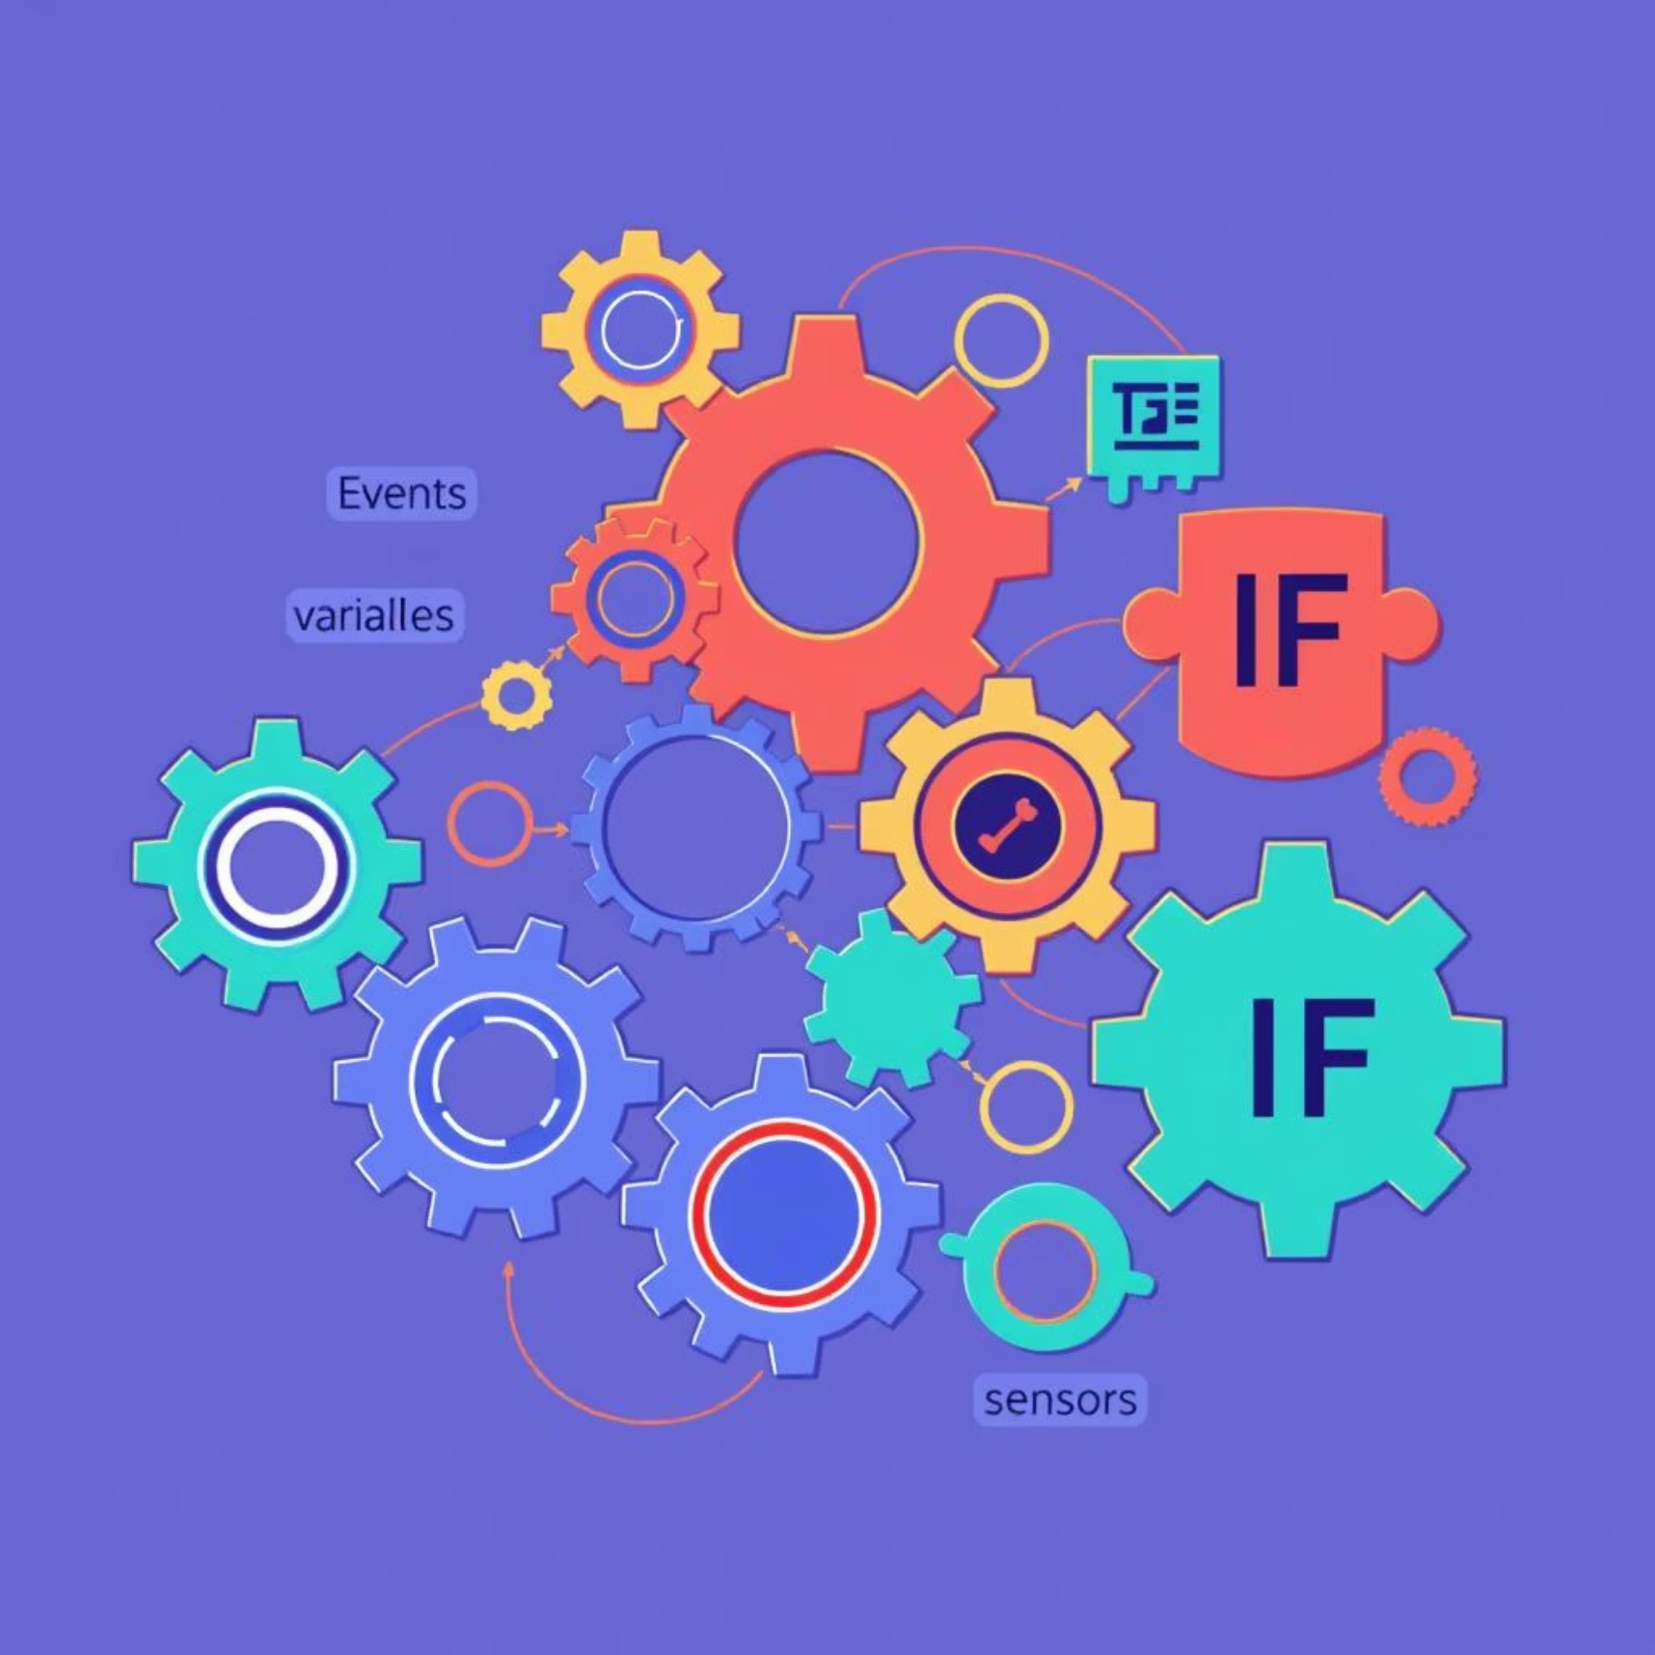
The Power of Combination
Real programs don't just use one concept—they combine many to create powerful, functional systems.
Why Combine Concepts?
Games: Events trigger actions, variables track scores, IF statements create rules for engaging gameplay.
Smart Devices: Sensors detect conditions, variables remember settings, and events respond to changes.
Apps: All concepts work together to deliver complex functionality and a seamless user experience.
Today's goal: build systems that demonstrate mastery of multiple programming concepts working together seamlessly.

Slide 3
Choose Your Integration Challenge
Pick ONE challenge card to build a complete system that combines multiple programming concepts:
🟢 Green Card: Multi-Event Tracker
🟡 Yellow Card: Smart Scoring System
Combines: Events + Variables + Display
Combines: Events + Variables + IF statements + Calculations
Best for: Students comfortable with basic variables, focusing on clear data presentation.
Best for: Students ready for conditional logic challenges and dynamic scoring.

Slide 4
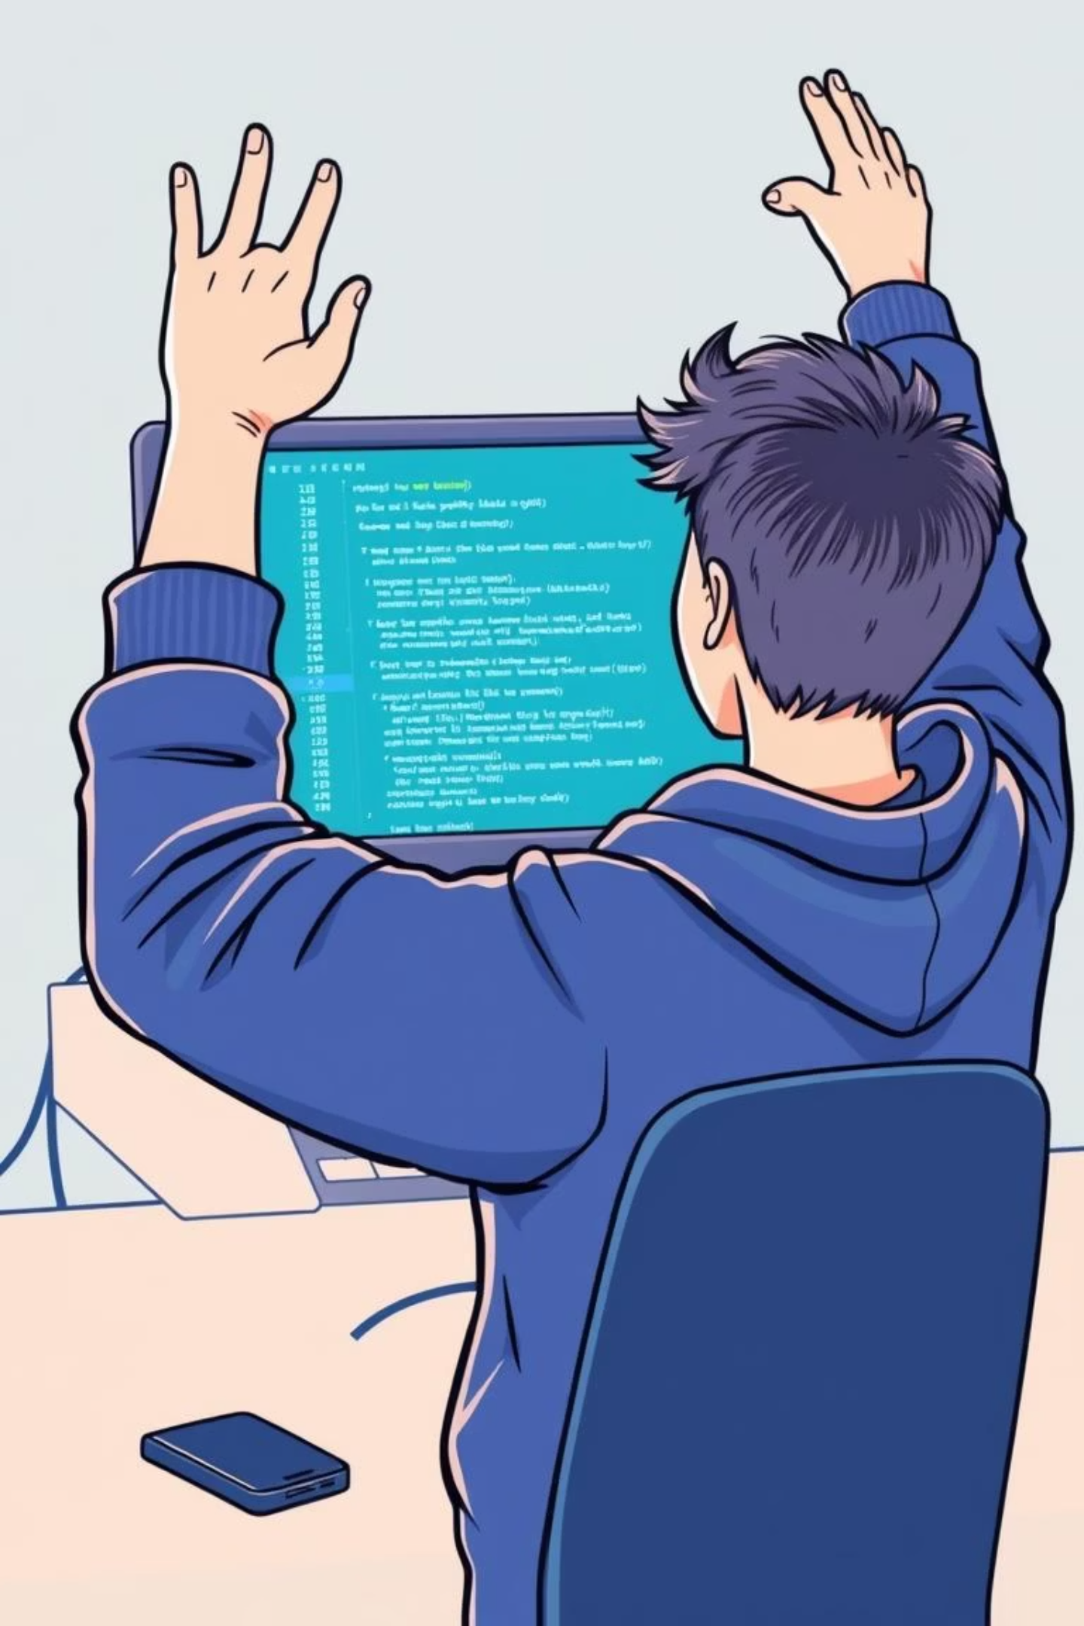
🔴 Red Card: Achievement System
Combines: Events + Variables + IF statements + Complex logic
Best for: Students wanting maximum programming challenge with intricate rule sets.
Success Goal: Your system should feel like a complete, polished experience that others can interact with and understand effortlessly.

Slide 5

Integration Check & Peer Review
Discuss with your team:
Which programming concepts is your system using?
How do the different concepts work together?
What makes your system feel "complete" rather than just individual parts?
How would you explain your system to someone who's never seen it?
Peer Testing:
Have someone else try your system.
Can they figure out how it works?
Does it respond predictably to their actions?
What suggestions do they have?

Slide 6
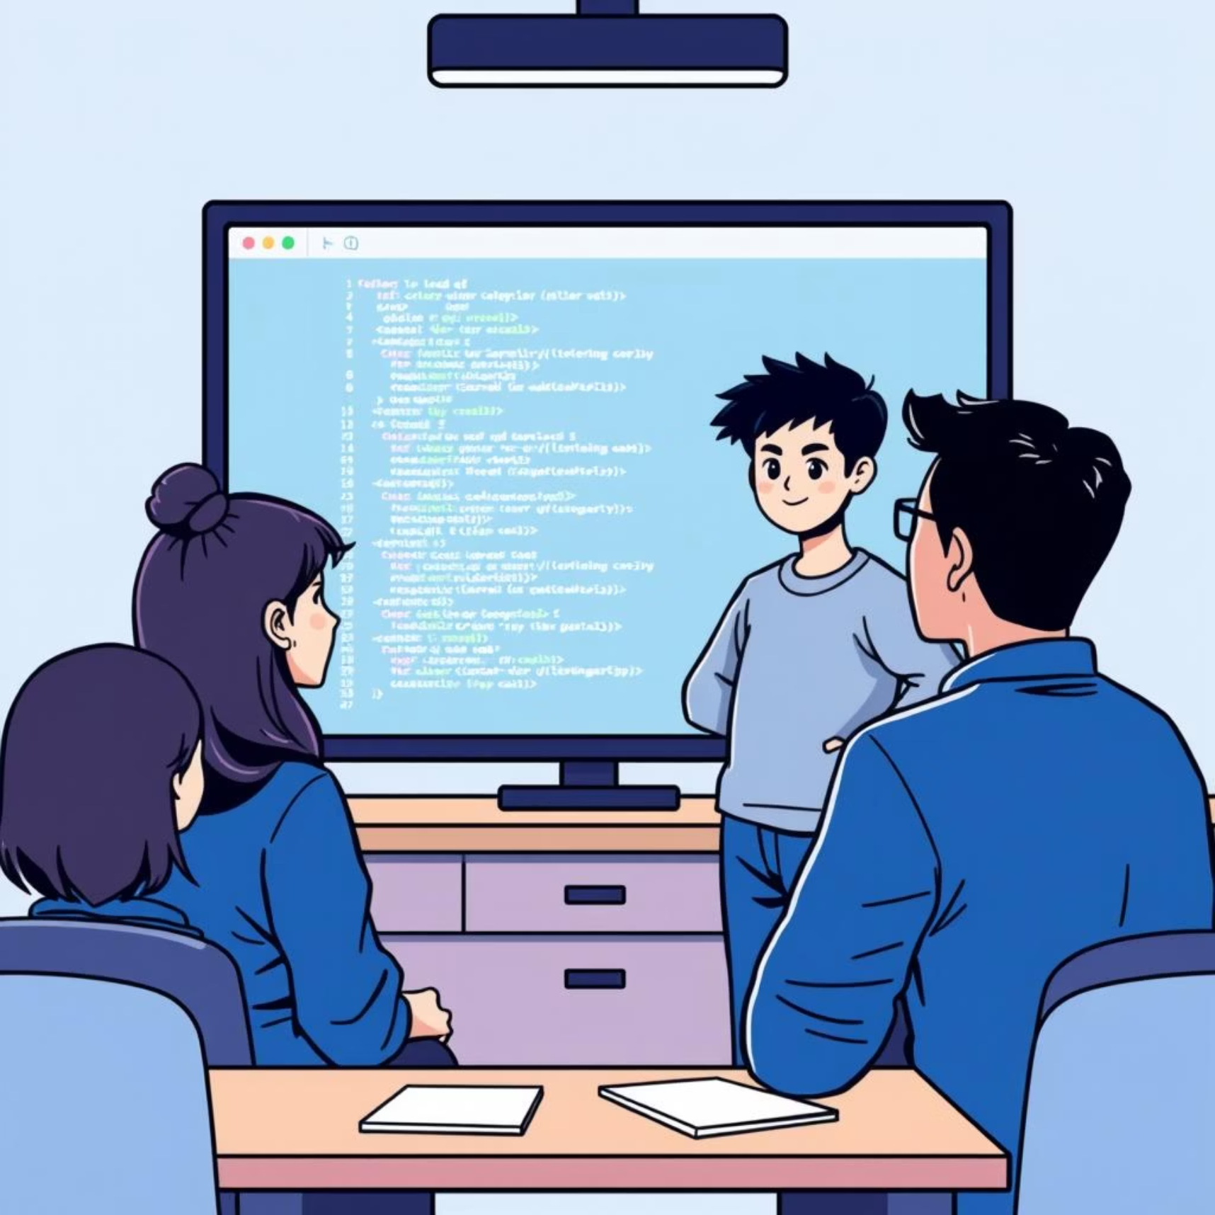
Showcase Your Mastery
Presentation Format:
Show your system in action, demonstrating its key features.
Explain which programming concepts you combined and why.
Describe the most challenging part to build and how you overcame it.
Demo how others can interact with your system, highlighting user experience.
Class Discussion:
Which combinations of concepts created the most interesting systems?
What programming concept was most essential for your project's success?
How could you extend your system further, adding new features or complexity?

Slide 7

Programming Journey Complete!
You've come so far! Reflect on your incredible learning journey:
Simple Sequences
You started with basic, sequential instructions.
Efficiency with Loops
You added repetition for cleaner, more powerful code.
Interactivity with Events
Your programs began responding to user actions.
Intelligence with IF Statements
Your programs learned to make decisions.
Memory with Variables
Your programs remembered and manipulated data.
Complete Systems!
Now, you're combining everything into cohesive, functional creations!
Exit Ticket:
Most satisfying programming concept to master: ____________
One way programming thinking will help you outside of class: ____________
Next programming challenge you'd like to try: ____________
Celebration: You now think like programmers – breaking down complex problems and building powerful solutions!

